Slide 1

Employee performance analysis

Slide 2

Employee Data analysis using excel
Student name :S.Jagan
Register No. : 312211622
Department. :Bcom(General)
College. : Thiruthangal Nadar college

Slide 3

Problems statement
- Identify areas of improvement in employee performance
- Reduce turnover and increase productivity
- Enhance fair and transparent performance evaluations

Slide 4
Project overview
- Analyze employee performance data to identify trends and insights
- Develop a comprehensive performance management system
- Improve employee engagement and growth

Slide 5
End users
- HR Department
- Managers and Supervisors
- Employees

Slide 6
Our solution and proportion
- Create a user-friendly Excel dashboard for performance tracking
- Implement a standardized evaluation framework
- Provide data-driven insights for informed decision-making

Slide 7
Data discription
- Employee data: ID, name, department, role, tenure
- Performance data: ratings, goals, feedback, absences
- Excel data sources: HRIS, performance management software

Slide 8
Modeling approach
- Descriptive analytics: summary statistics, visualizations
- Inferential analytics: correlation, regression analysis
- Excel tools: PivotTables, charts, conditional formatting

Slide 9
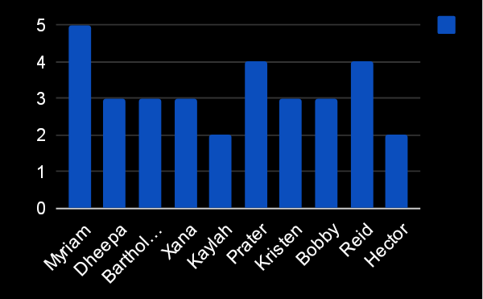
Result in bar diagram

Slide 10
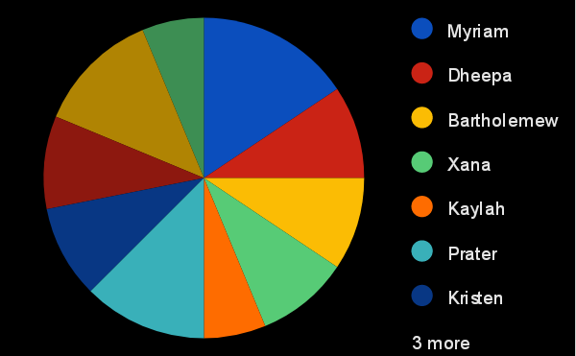
Result in pie chart

Slide 11
Conclusion
- Summary of findings and implications
- Future directions: continuous monitoring, predictive analytics
- Excel dashboard maintenance and updates

Slide 12


